Slide 1


Sales Insights - Data Analysis Project using Tableau
By – AMAR SINGH YADAV
github.com/mrankitgupta
linkedin.com/in/mrankitgupta

Slide 2
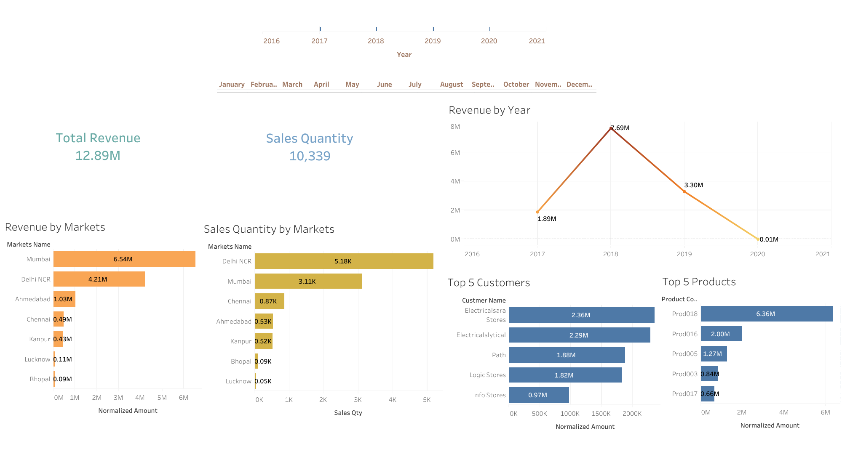

Slide 3
